Slide 1
Data Structures
17. Binary Search Tree
17-BST
1

Slide 2
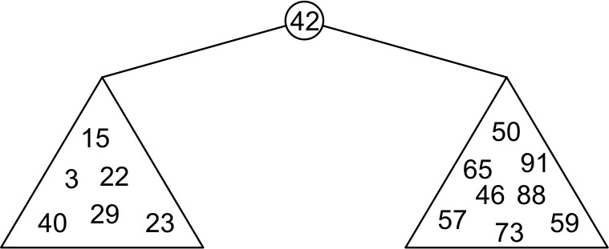
Binary Search Tree (BST)
With a binary tree, we can dictate an order on the two children
Binary Search Tree (BST) defines the following order:
All elements in the left sub-tree to be less than the element stored in the root node, and
All elements in the right sub-tree to be greater than the element in the root object
subtrees will themselves be binary search trees

Slide 3
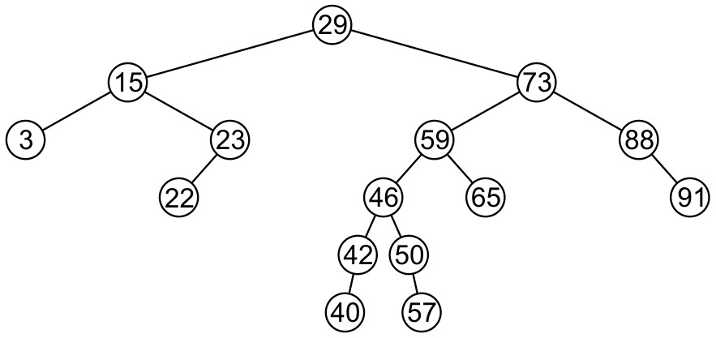
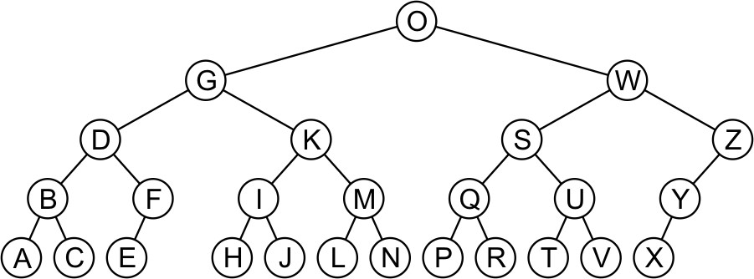
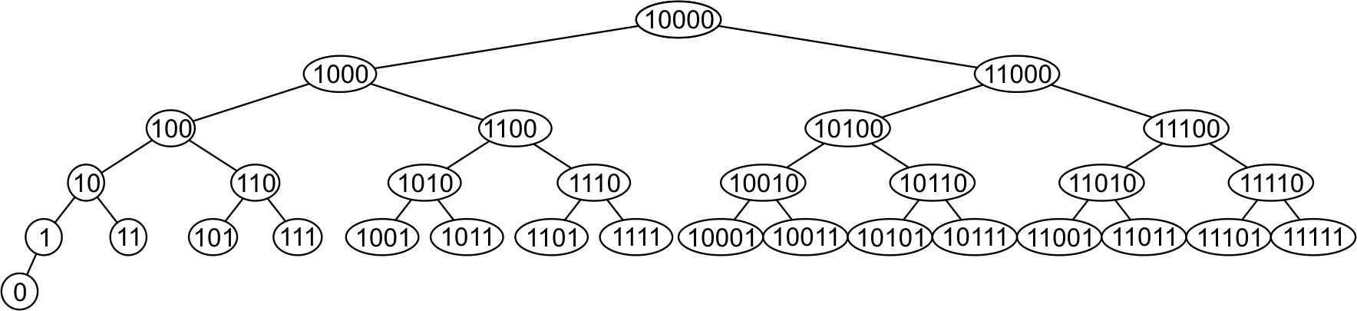
Binary Search Tree (BST) – Example (1)

Slide 4
Binary Search Tree (BST) – Example (2)
5
10
2
45
10
5
30
5
45
30
2
25
45
10
2
25
30
BST
25
Not BST
BST

Slide 5
Applications of Binary Trees
Searching any linear data structure, such as an array or a standard linked list, is slow when the structure holds a large amount of data
This is because of the sequential nature of linear data structures
Binary trees are excellent data structures for searching large amounts of data
They are commonly used in database applications to organize key values that index database records
When used to facilitate searches, a binary tree is called a binary search tree
DATA IS STORED IN BINARY SEARCH TREES IN A WAY THAT MAKES A BINARY SEARCH SIMPLE

Slide 6
BST Operations
Many operations one can perform on a binary search tree
Creating a binary search tree
Finding a node in a binary search tree
Inserting a node into a binary search tree
Deleting a node in a binary search tree
Traversing a binary search tree
In the following, we will examine the algorithms and examples for all of the above operations

Slide 7
Creating BST
A simple class that implements a binary tree to store integer values
– A class called IntBinaryTree
Node of binary search tree
struct TreeNode
{
int value; TreeNode *left; TreeNode *right;
};

Slide 8
Creating BST – Class Definition
class IntBinaryTree {
private:
TreeNode *root;
// Pointer to the root of BST
void destroySubTree(TreeNode *); //Recursively delete all tree nodes void deleteNode(int, TreeNode *&);
void makeDeletion(TreeNode *&); void displayInOrder(TreeNode *); void displayPreOrder(TreeNode *); void displayPostOrder(TreeNode *);
public:
IntBinaryTree()
~IntBinaryTree()
void insertNode(int);
bool find(int);
void remove(int);
void showNodesInOrder() void showNodesPreOrder() void showNodesPostOrder()
{ root = NULL; }
{ destroySubTree(root); }
{ displayInOrder(root); }
{ displayPreOrder(root); }
{ displayPostOrder(root); }
};

Slide 9
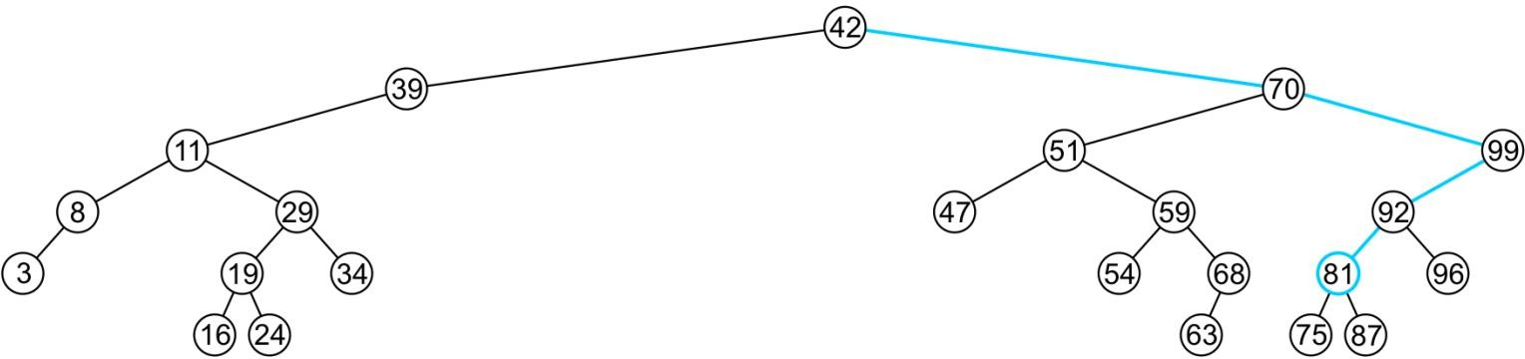
Finding a Node in BST
Recall that a BST has the following key property (invariant):
Smaller values in left sub-tree
Larger values in right sub-tree
For example: find (81)
Returns true if found

Slide 10
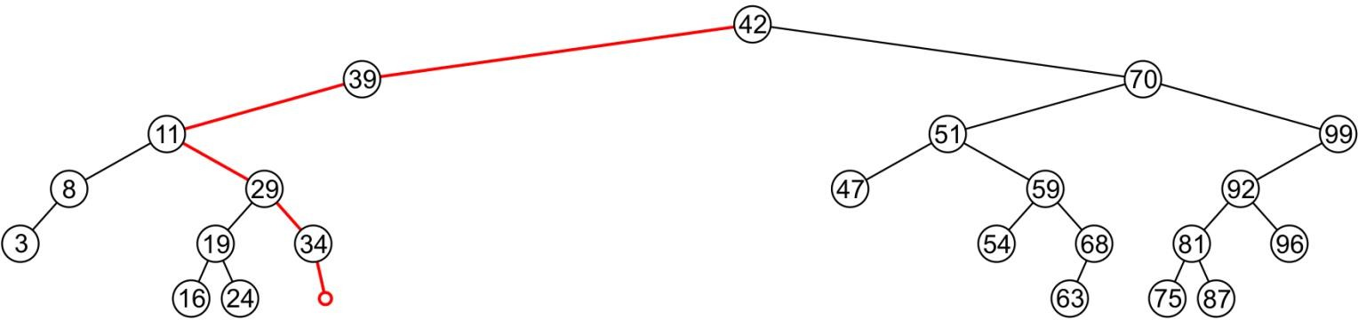
Finding a Node in BST
Recall that a BST has the following key property (invariant):
Smaller values in left sub-tree
Larger values in right sub-tree
For example: find (36)
Returns false if not found

Slide 11
Finding a Node in BST
Example: find(2)
root
10
10 > 2, left
5 > 2, left
2 = 2, found
5
30
2
25 45

Slide 12
Finding a Node in BST
Example: find(25)
root
5
5 < 25, right
45 > 25, left
30 > 25, left
10 < 25, right
25 = 25, found
2
45
30
10
25

Slide 13
Finding a Node in BST – Implementation
bool IntBinaryTree::Find(int num){
// The function starts from the root
TreeNode *nodePtr = root;
while (nodePtr) {
if (nodePtr->value == num)
return true; // value is found
else if (num < nodePtr->value) nodePtr = nodePtr->left;
else
nodePtr = nodePtr->right;
10
10 < 25, right
}
return false; // value not found
5
30
30 > 25, left
}
2
25 45
25 = 25, found

Slide 14
Finding a Node in BST – Recursive Implementation
bool IntBinaryTree::search(TreeNode* nodePtr, int value) const
{
if (nodePtr == nullptr)
return false; // Base case: not found
if (value == nodePtr->value)
return true; // Base case: found
else if (value < nodePtr->value)
return search(nodePtr->left, value); // Recurse left
else
return search(nodePtr->right, value); // Recurse right
}

Slide 15
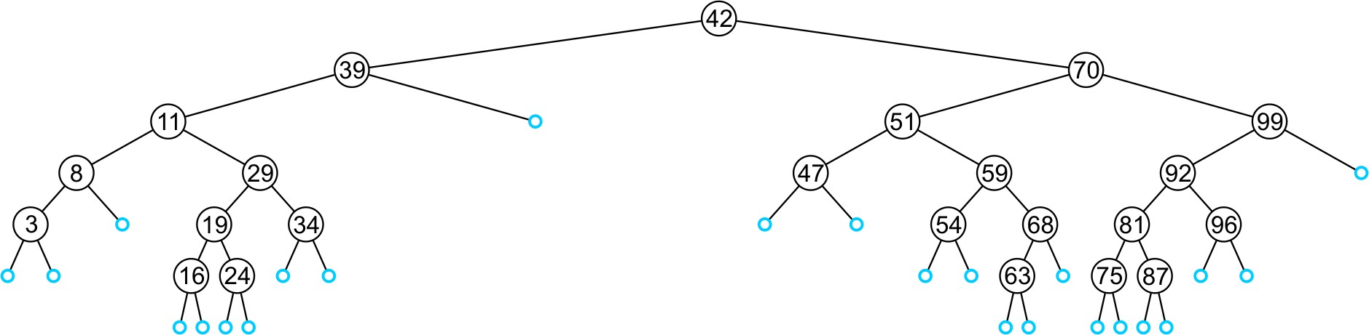
Inserting a Node in BST
An insertion will be performed at a leaf node
– Any empty node is a possible location for an insertion
Values which may be inserted at any empty node depend on the surrounding nodes

Slide 16
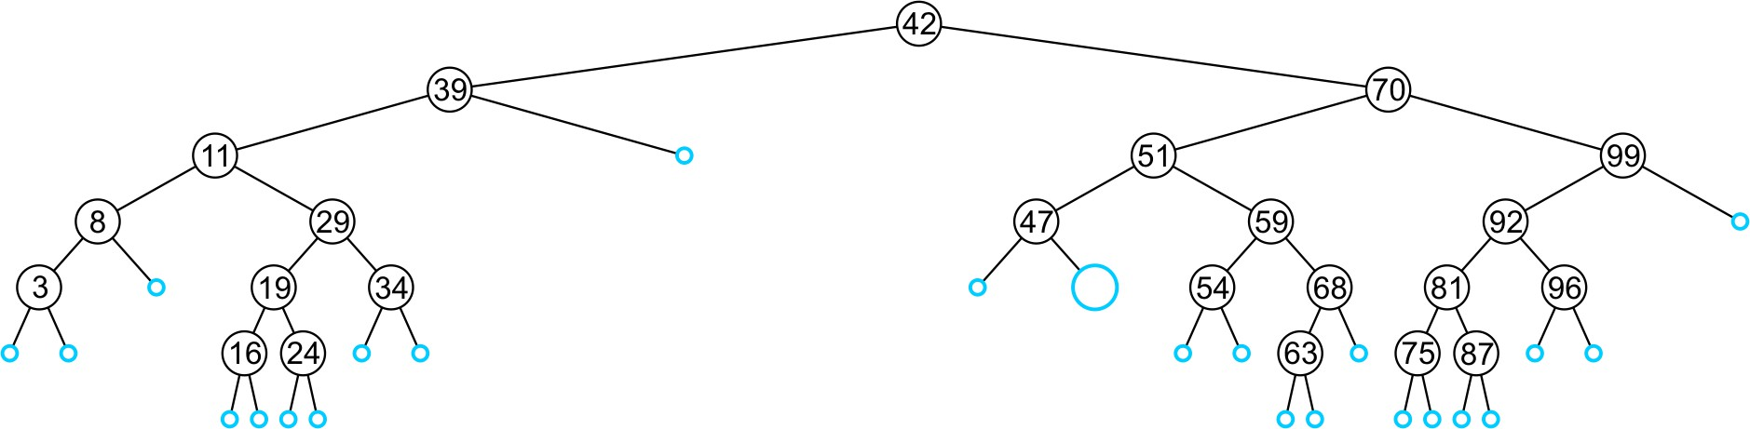
Inserting a Node in BST
Which values can be held by empty node?
This node may hold 48, 49, or 50

Slide 17
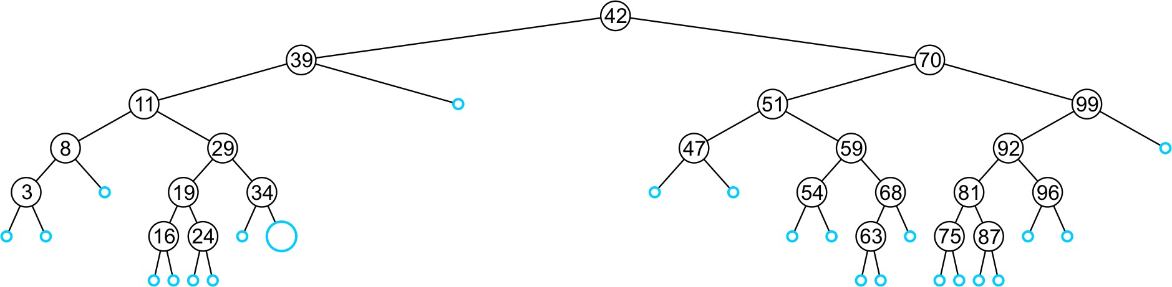
Inserting a Node in BST
Which values can be held by empty node?
This node may hold 35, 36, 37 or 38

Slide 18
Inserting a Node in BST – Algorithm
Like find, algorithm will step through the tree
If algorithm find the object already in the tree, it will return
The object is already in the binary search tree (no duplicates)
Otherwise, algorithm will arrive at an empty node
The object will be inserted into that location
Why no duplicates?
In reality, it is seldom the case where duplicate elements in a BST must be stored as separate entities

Slide 19
Inserting a Node in BST – Example
insertNode(20)
10
10 < 20, right
30 > 20, left
25 > 20, left Insert 20 on left
5
30
2
25 45
20

Slide 20
Inserting a Node in BST – Implementation
void IntBinaryTree::insertNode(int num) {
TreeNode* newNode = new TreeNode; // Create a new node newNode->value = num;
newNode->left = newNode->right = NULL;
if (!root) root = newNode; // If tree is empty.
else { // Tree is not empty
TreeNode* nodePtr = root; // create a pointer to traverse the tree
while ( true ) {
if (num < nodePtr->value) { // Left subtree
if (nodePtr->left) { nodePtr = nodePtr->left; }
else { nodePtr->left = newNode; return; }
}
else if (num > nodePtr->value) { // Right subtree
if (nodePtr->right) nodePtr = nodePtr->right; else { nodePtr->right = newNode; return; }
}
else { cout << "Duplicate value found in tree.\n"; break; }
}
}
}

Slide 21
Inserting a Node in BST – Recursive Implementation
void IntBinaryTree::insert(TreeNode*& nodePtr, int value)
{
if (nodePtr == nullptr)
{
nodePtr = new TreeNode;
nodePtr->value = value;
nodePtr->left = nullptr;
nodePtr->right = nullptr;
}
else if (value < nodePtr->value)
insert(nodePtr->left, value);
else if (value > nodePtr->value)
insert(nodePtr->right, value);
else
{
cout << "Duplicate value ignored" << endl;
}
}
}

Slide 22
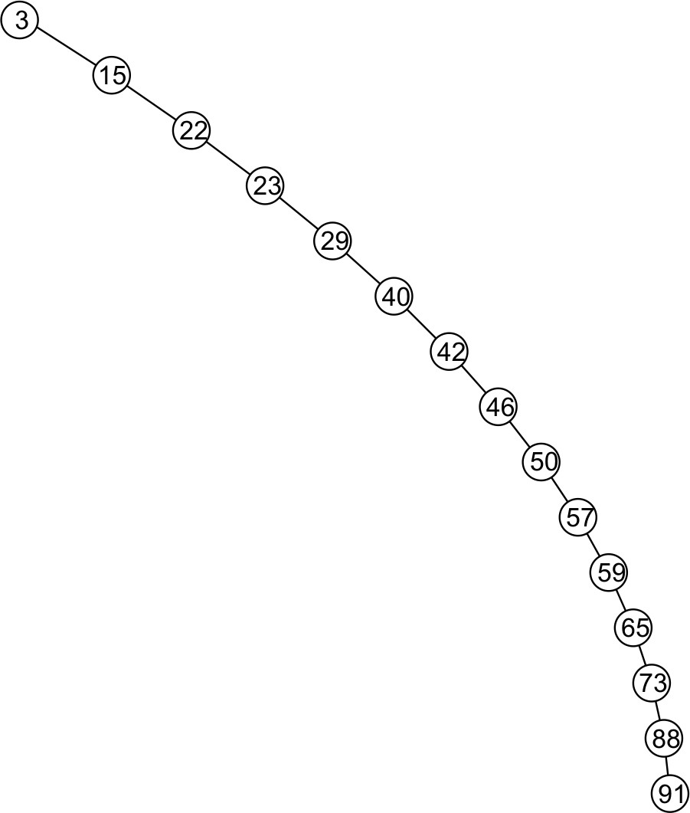
Inserting a Node in BST – Observation (1)
Insertion may unbalance the tree
It is possible to construct degenerate BST
– The example is equivalent to a linked list

Slide 23
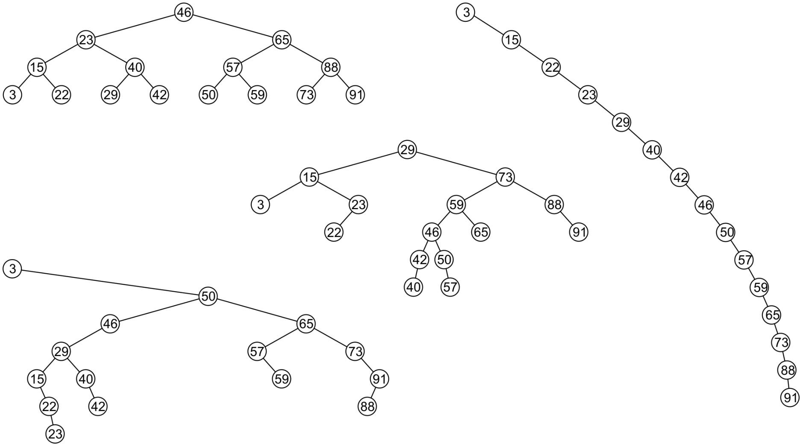
Inserting a Node in BST – Observation (2)
All these binary search trees store the same data
– Resultant tree depends on the order in which the values are inserted

Slide 24
Inserting a Node in BST – Observation (3)
All these binary search trees store the same data
– Resultant tree depends on the order in which the values are inserted
– What is the best way to ensure we create a height-balanced tree?

Slide 25
Using BST (1)
// This program builds a binary tree with 5 nodes.
// The SearchNode function determines if the
// value 3 is in the tree.
#include <iostream.h>
Output:
Inserting nodes.
3 is found in the tree.
#include "IntBinaryTree.h“
void main(void)
{
IntBinaryTree tree;
cout << "Inserting nodes.\n"; tree.insertNode(5); tree.insertNode(8); tree.insertNode(3); tree.insertNode(12); tree.insertNode(9);
if (tree.searchNode(3))
cout << "3 is found in the tree.\n"; else
cout << "3 was not found in the tree.\n";
}

Slide 26
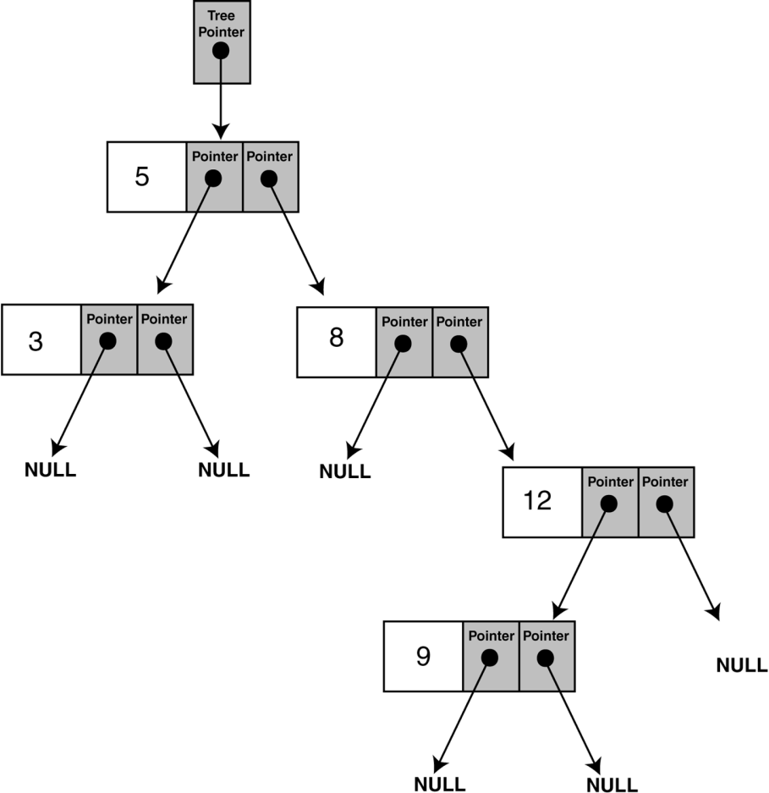
Using BST (2)
Structure of binary tree built by the program

Slide 27
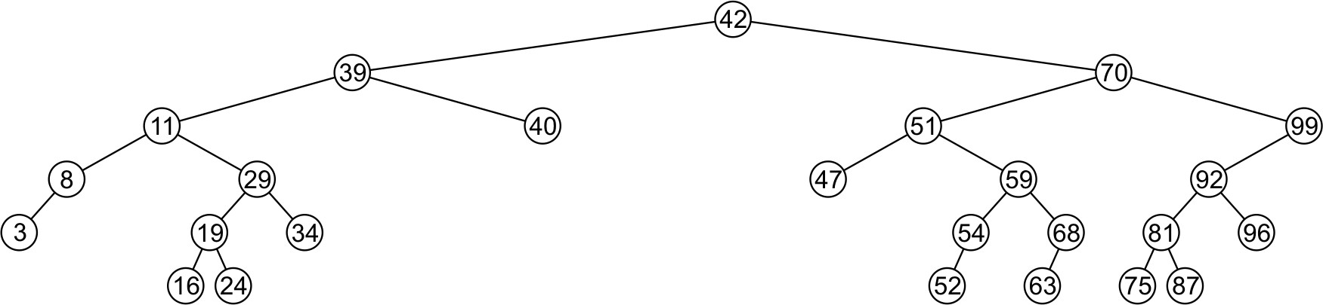
Deleting a Node
A node being erased is not always going to be a leaf node
There are three possible scenarios:
The node is a leaf node,
It has exactly one child, or
It has two children (it is a full node)

Slide 28
Deleting a Node – Leaf Node
Deleting a leaf node is easy
Find its parent
Set the child pointer that links to it to NULL
Free the node’s memory
Consider deleting node containing 25
10
10 < 25, right
30 > 25, left
25 = 25, delete
10
5
30
5
30
2
25 45
2
45

Slide 29
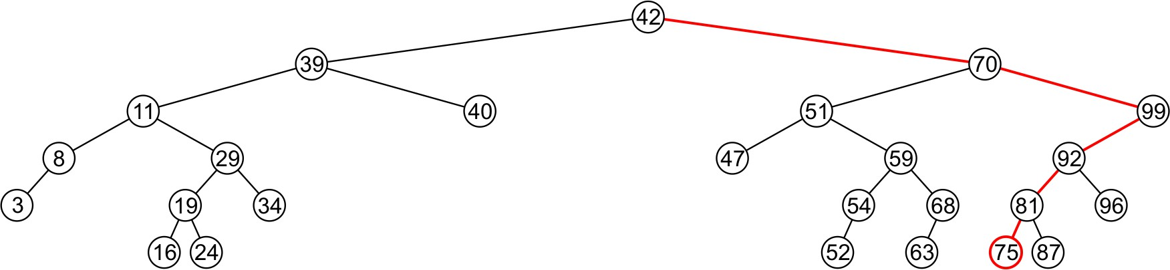
Deleting a Node – Leaf Node
Consider deleting node containing 75

Slide 30
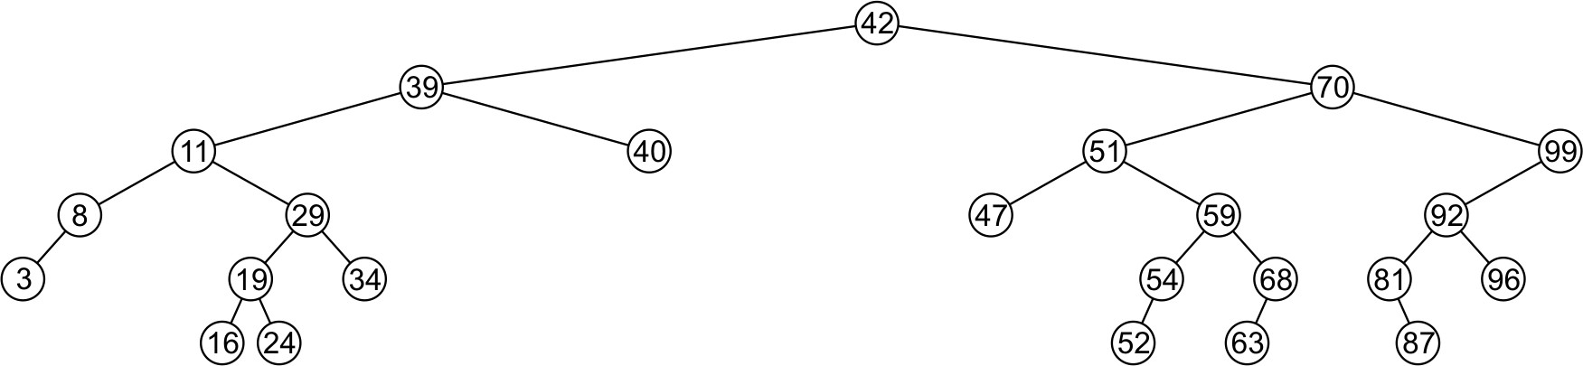
Deleting a Node – Leaf Node
Consider deleting node containing 75
– The node is deleted and left child of 81 is set to NULL

Slide 31
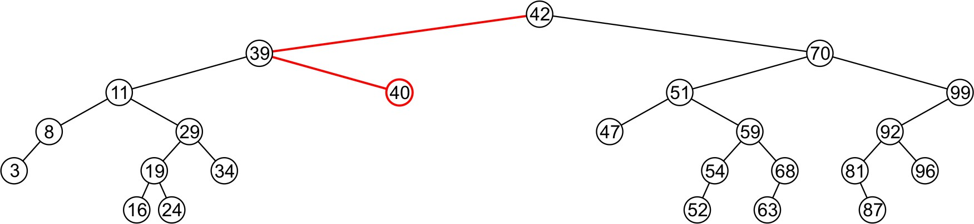
Deleting a Node – Leaf Node
Consider deleting node containing 40

Slide 32
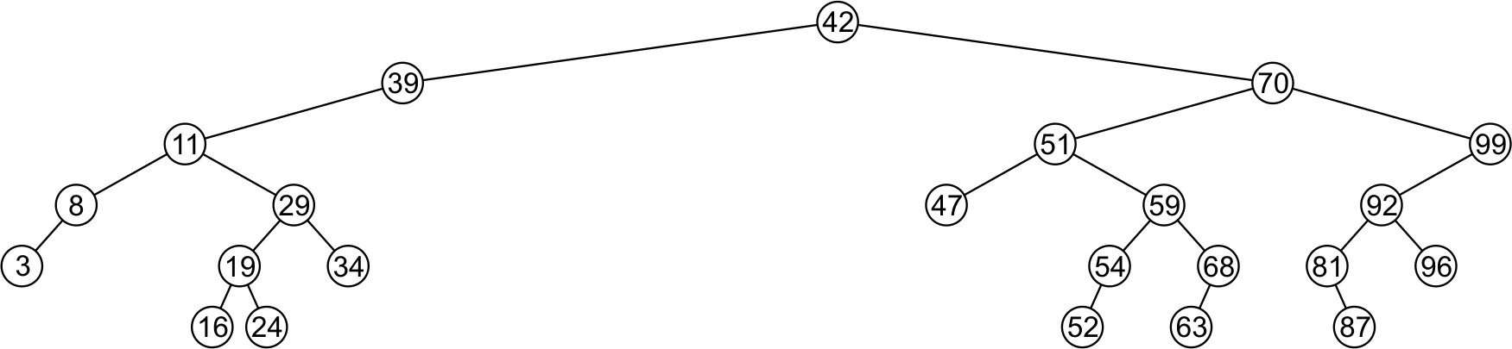
Deleting a Node – Leaf Node
Consider deleting node containing 40
– Node is deleted and right child of 39 is set to NULL

Slide 33
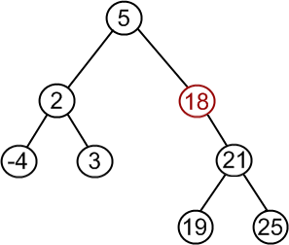
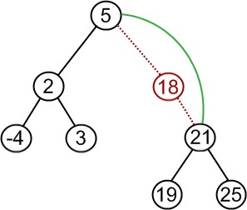
Deleting a Node – Node With Child
If a node has only one child (left or right)
– Simply promote the subtree associated with the child
Consider deleting 18 which has one right child
– Node 18 is deleted and right tree of node 5 is update to point to 21

Slide 34
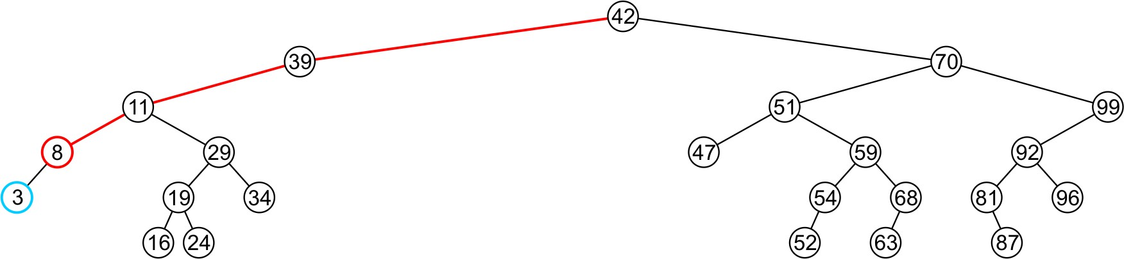
Deleting a Node – Node With Child
Consider deleting 8 which has one left child

Slide 35
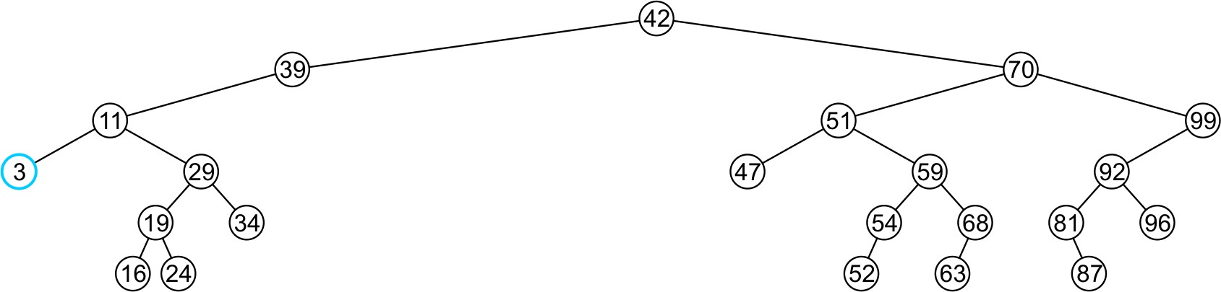
Deleting a Node – Node With Child
Consider deleting 8 which has one left child
– Node 8 is deleted and the left tree of 11 is updated to point to 3

Slide 36
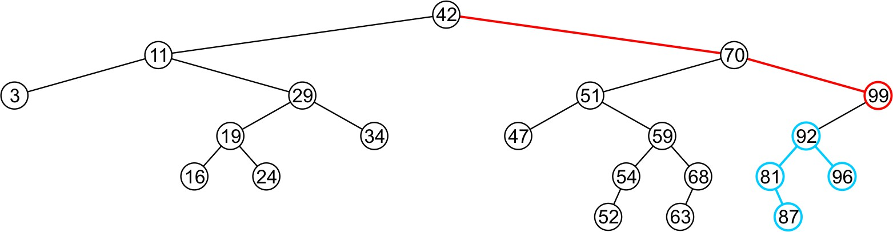
Deleting a Node – Node With Child
Consider deleting the node containing 99

Slide 37
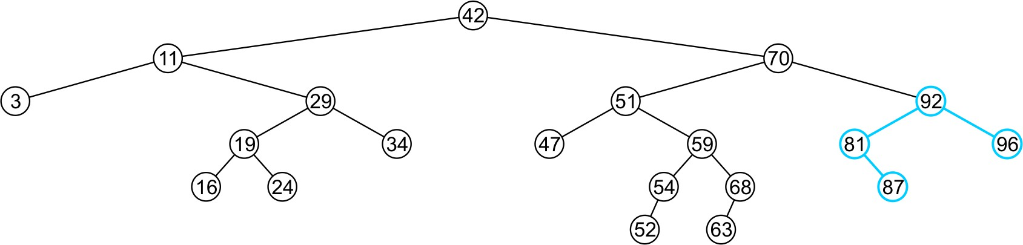
Deleting a Node – Node With Child
Consider deleting the node containing 99
The right tree of 70 is set to point to node 92
Again, the order of the tree is maintained

Slide 38
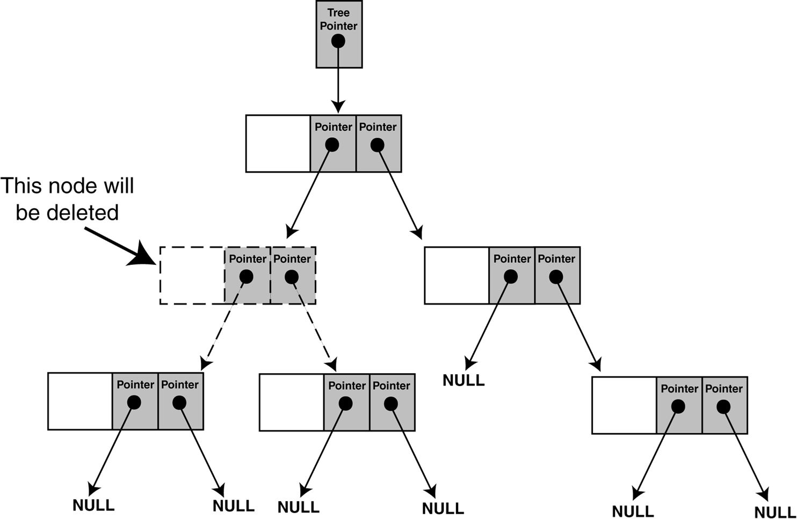
Deleting a Node – Node With Two Children
The problem is not as easily solved if the node has two children

Slide 39
Deleting a Node – Node With Two Children
Suppose node p with two children has to be deleted
Find a position in the right subtree of p to attach its left subtree
Left most node in the right subtree of node p
Attach the right subtree of node p to its parent
Consider deleting 10
10
30
30
10
25 45
25 45
5
30
5
5
Attach left subtree of 10 to that
node, i.e., 25
Attach right subtree of 10 to its parent
2 25 45
Find left most node of right subtree of 10
2
2
17-BST
35

Slide 40
Pointers Review
Pointer to Pointer versus reference to Pointer?
int g_One=1;
void func(int* pInt); int main()
{
int nvar=2; int* pvar=&nvar; func(pvar);
std::cout<<*pvar<<std::endl; return 0;
}
void func(int* pInt)
{
pInt=&g_One;
}
int g_One=1;
void func(int*& rpInt); int main()
{
int nvar=2; int* pvar=&nvar; func(pvar);
std::cout<<*pvar<<std::endl; return 0;
}
void func(int*& rpInt)
{
rpInt=&g_One;
}

Slide 41
Concept: Pointer addresses are essentially passed by value, but when that address is dereferenced, we are able to access the value of the variable, thereby accomplishing pass by reference.
int num1 = 10;
int num2 = 20;
int main() {
int * ptr = &num1; cout<<*ptr<<"\t"<<ptr<<"\t"<<&ptr<<endl<<endl;
checking(ptr); cout<<*ptr<<"\t"<<ptr<<"\t"<<&ptr<<endl<<endl;
}
void checking(int *ptr2){
cout<<*ptr2<<"\t"<<ptr2<<"\t"<<&ptr2<<endl<<endl;
ptr2 = &num2;
cout<<*ptr2<<"\t"<<ptr2<<"\t"<<&ptr2<<endl<<endl;
}

Slide 42
Deleting a Node – Implementation
class IntBinaryTree {
private:
TreeNode *root;
// Pointer to the root of BST
void destroySubTree(TreeNode *); //Recursively delete all tree nodes
void deleteNode(int, TreeNode *&);
void makeDeletion(TreeNode *&);
void displayInOrder(TreeNode *); void displayPreOrder(TreeNode *); void displayPostOrder(TreeNode *);
The argument passed to the remove function is the value of the node to be deleted.
public:
IntBinaryTree()
~IntBinaryTree()
void insertNode(int);
bool find(int);
void remove(int num); void showNodesInOrder() void showNodesPreOrder() void showNodesPostOrder()
{ root = NULL; }
{ destroySubTree(root); }
{ deleteNode( num, root)}
{ displayInOrder(root); }
{ displayPreOrder(root); }
{ displayPostOrder(root); }
};

Slide 43
Deleting a Node – Implementation
void IntBinaryTree::deleteNode(int num, TreeNode *&nodePtr)
{
if (nodePtr == NULL) // node does not exist in the tree
cout << num <<“ not found.\n";
else if (num < nodePtr->value)
deleteNode(num, nodePtr->left); // find in left subtree else if (num > nodePtr->value)
deleteNode(num, nodePtr->right); // find in right subtree
else // num == nodePtr->value i.e. node is found makeDeletion(nodePtr); // actually deletes node from BST
}
Note:
The declaration of the nodePtr parameter: TreeNode *&nodePtr;
nodePtr is a reference to a pointer to a TreeNode structure
– Any action performed on nodePtr is actually performed on the argument passed into nodePtr

Slide 44
void IntBinaryTree::makeDeletion(TreeNode*& nodePtr) {
TreeNode* tempNodePtr; // Temperary pointer
if (nodePtr->right == NULL) { // case for leaf and one (left) child
tempNodePtr = nodePtr;
nodePtr = nodePtr->left; // Reattach the left child
delete tempNodePtr;
}
else if (nodePtr->left == NULL) { // case for one (right) child
tempNodePtr = nodePtr;
nodePtr = nodePtr->right; // Reattach the right child
delete tempNodePtr;
}
else { // case for two children.
tempNodePtr = nodePtr->right; // Move one node to the right
while (tempNodePtr->left) { // Go to the extreme left node
tempNodePtr = tempNodePtr->left;
}
tempNodePtr->left = nodePtr->left; // Reattach the left subtree
tempNodePtr = nodePtr;
nodePtr = nodePtr->right; // Reattach the right subtree
delete tempNodePtr;
}
}

Slide 45
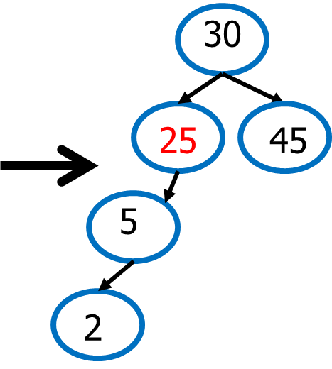
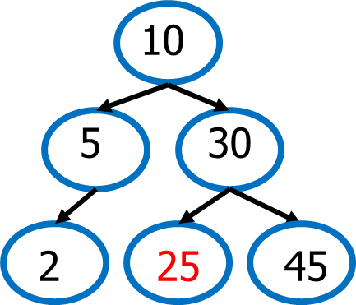
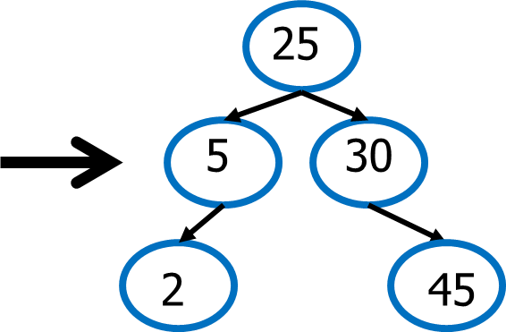
Deleting a Node – Node With Two Children
Problem: Height of the BST increases
A better Solution to delete node p with two children
Replace node p with the minimum object in the right subtree
Delete that object from the right subtree

Slide 46
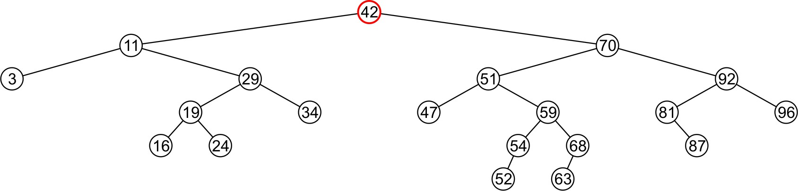
Deleting a Node Two Children – Better Solution
Consider the problem of deleting a full node, e.g., 42

Slide 47
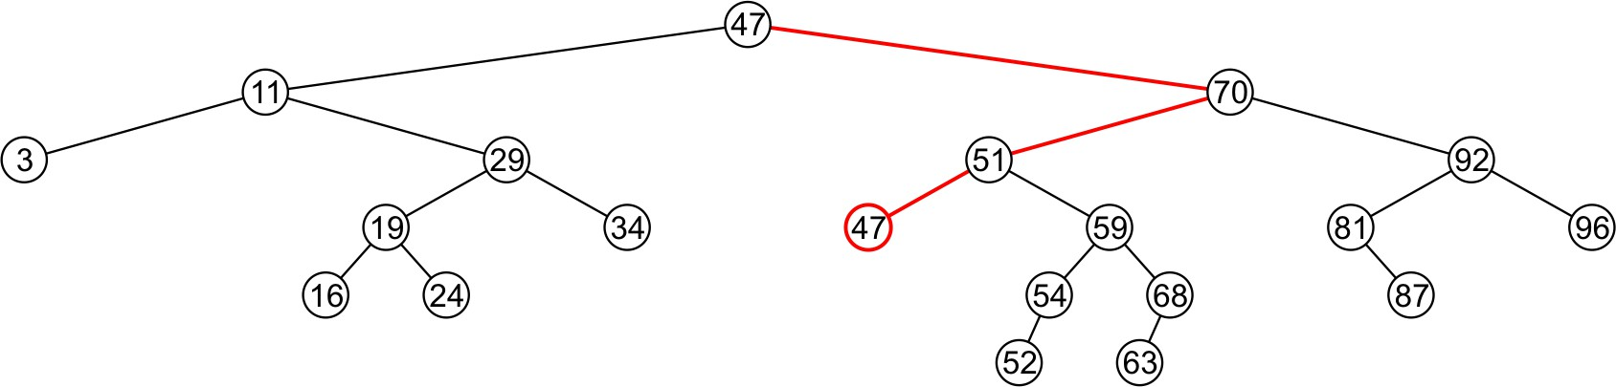
Deleting a Node Two Children – Better Solution
Consider the problem of deleting a full node, e.g., 42
– Find minimum object in the right subtree, i.e., 47

Slide 48
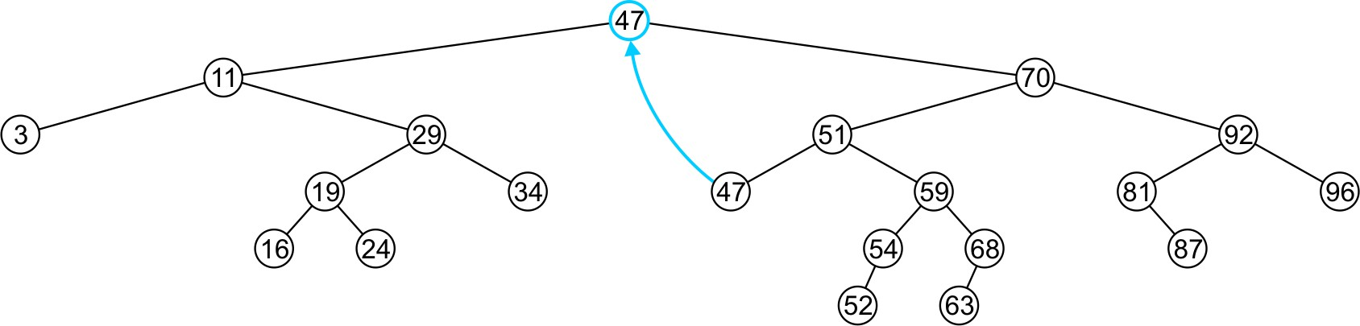
Deleting a Node Two Children – Better Solution
Consider the problem of deleting a full node, e.g., 42
Find minimum object in the right subtree, i.e., 47
Replace 42 with 47

Slide 49
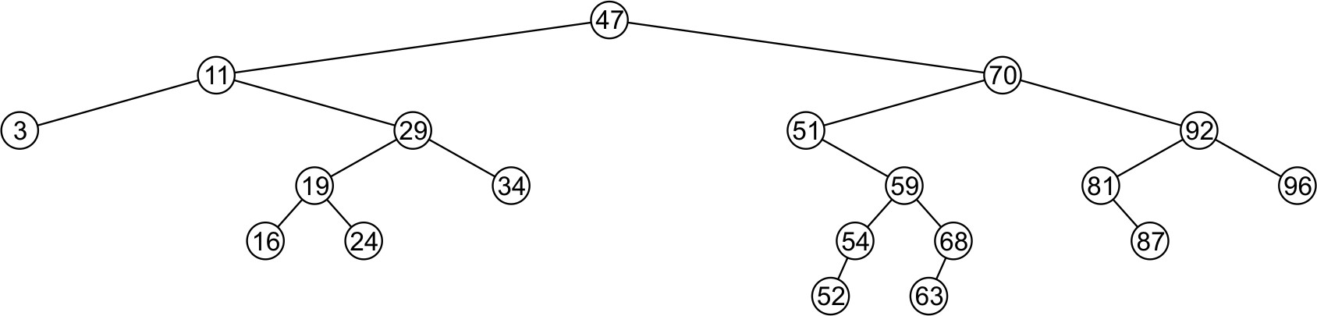
Deleting a Node Two Children – Better Solution
Consider the problem of deleting a full node, e.g., 42
Find minimum object in the right subtree, i.e., 47
Replace 42 with 47
Delete the leaf node 47

Slide 50
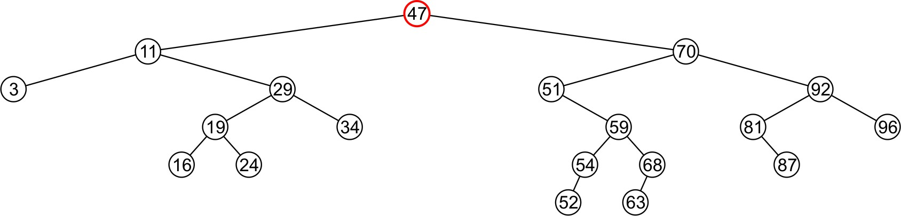
Deleting a Node Two Children – Better Solution
Consider the problem of deleting a full node, e.g., 47

Slide 51
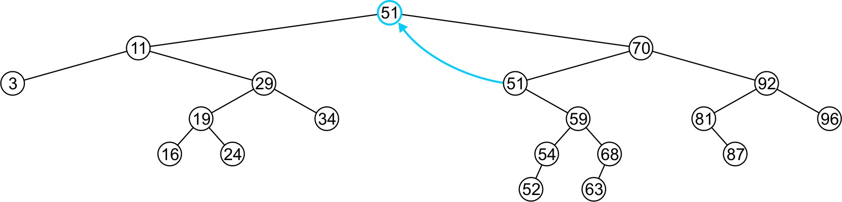
Deleting a Node Two Children – Better Solution
Consider the problem of deleting a full node, e.g., 47
– Replace 47 with 51

Slide 52
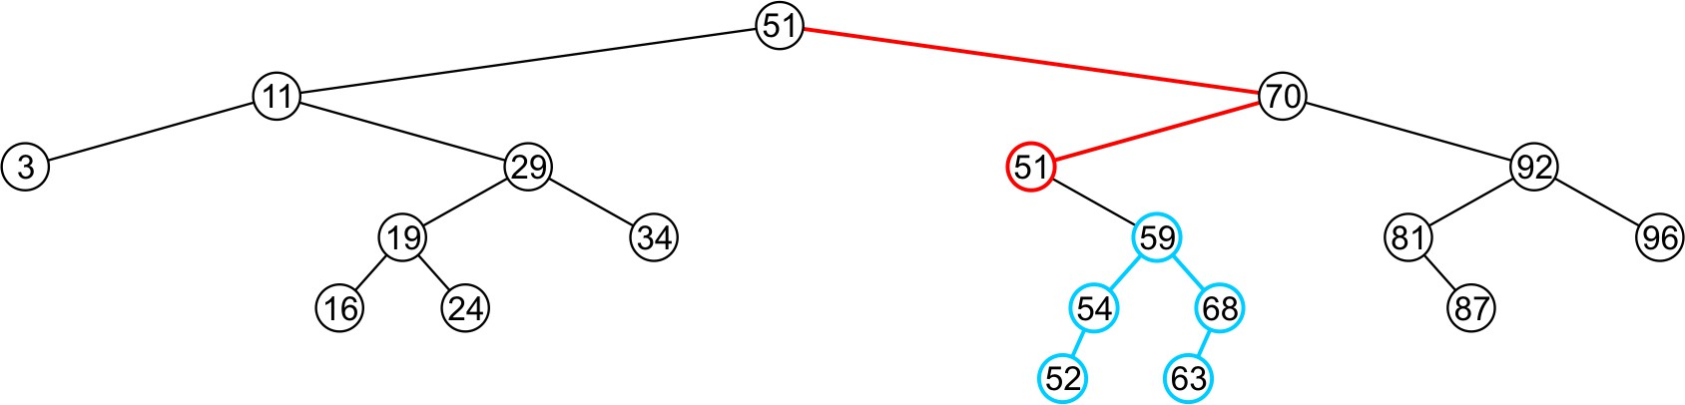
Deleting a Node Two Children – Better Solution
Consider the problem of deleting a full node, e.g., 47
Replace 47 with 51
Node 51 is not a leaf node

Slide 53
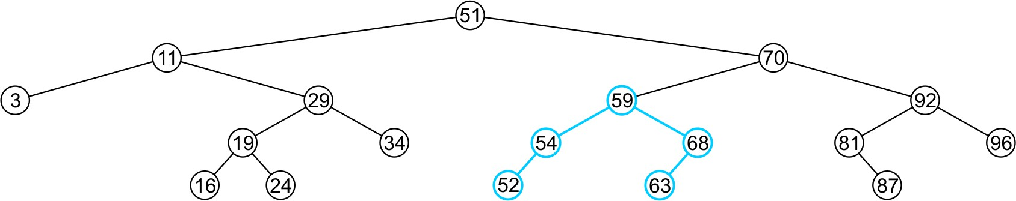
Deleting a Node Two Children – Better Solution
Consider the problem of deleting a full node, e.g., 47
Replace 47 with 51
Node 51 is not a leaf node
Assign the left subtree of 70 to point to 59

Slide 54
Pointers Review
Pointer to Pointer versus reference to Pointer?
int g_One=1;
void func(int* pInt); int main()
{
int nvar=2; int* pvar=&nvar; func(pvar);
std::cout<<*pvar<<std::endl; return 0;
}
void func(int* pInt)
{
pInt=&g_One;
}
int g_One=1;
void func(int*& rpInt); int main()
{
int nvar=2; int* pvar=&nvar; func(pvar);
std::cout<<*pvar<<std::endl; return 0;
}
void func(int*& rpInt)
{
rpInt=&g_One;
}

Slide 55
Concept: Pointer addresses are essentially passed by value, but when that address is dereferenced, we are able to access the value of the variable, thereby accomplishing pass by reference.
int num1 = 10;
int num2 = 20;
int main() {
int * ptr = &num1; cout<<*ptr<<"\t"<<ptr<<"\t"<<&ptr<<endl<<endl;
checking(ptr); cout<<*ptr<<"\t"<<ptr<<"\t"<<&ptr<<endl<<endl;
}
void checking(int *ptr2){
cout<<*ptr2<<"\t"<<ptr2<<"\t"<<&ptr2<<endl<<endl;
ptr2 = &num2;
cout<<*ptr2<<"\t"<<ptr2<<"\t"<<&ptr2<<endl<<endl;
}

Slide 56
Deleting a Node – Implementation
class IntBinaryTree {
private:
TreeNode *root;
// Pointer to the root of BST
void destroySubTree(TreeNode *); //Recursively delete all tree nodes
void deleteNode(int, TreeNode *&);
void makeDeletion(TreeNode *&);
void displayInOrder(TreeNode *); void displayPreOrder(TreeNode *); void displayPostOrder(TreeNode *);
The argument passed to the remove function is the value of the node to be deleted.
public:
IntBinaryTree()
~IntBinaryTree()
void insertNode(int);
bool find(int);
void remove(int num); void showNodesInOrder() void showNodesPreOrder() void showNodesPostOrder()
{ root = NULL; }
{ destroySubTree(root); }
{ deleteNode( num, root)}
{ displayInOrder(root); }
{ displayPreOrder(root); }
{ displayPostOrder(root); }
};

Slide 57
Deleting a Node – Implementation
void IntBinaryTree::deleteNode(int num, TreeNode *&nodePtr)
{
if (nodePtr == NULL) // node does not exist in the tree
cout << num <<“ not found.\n";
else if (num < nodePtr->value)
deleteNode(num, nodePtr->left); // find in left subtree else if (num > nodePtr->value)
deleteNode(num, nodePtr->right); // find in right subtree
else // num == nodePtr->value i.e. node is found makeDeletion(nodePtr); // actually deletes node from BST
}
Note:
The declaration of the nodePtr parameter: TreeNode *&nodePtr;
nodePtr is a reference to a pointer to a TreeNode structure
– Any action performed on nodePtr is actually performed on the argument passed into nodePtr

Slide 58
Deleting a Node – Implementation
void IntBinaryTree::makeDeletion(TreeNode*& nodePtr) {
// Case 1: Leaf node (no children)
if (nodePtr->left == nullptr && nodePtr->right == nullptr){
delete nodePtr;
nodePtr = nullptr;
}
// Case 2: Node with only left child
else if (nodePtr->right == nullptr) {
TreeNode* tempNodePtr = nodePtr;
nodePtr = nodePtr->left;
delete tempNodePtr;
}
// Case 3: Node with only right child
else if (nodePtr->left == nullptr) {
TreeNode* tempNodePtr = nodePtr;
nodePtr = nodePtr->right;
delete tempNodePtr;
}

Slide 59
Deleting a Node – Implementation
// Case 4: Node with two children
else {
// Find the inorder successor (leftmost node in right subtree)
TreeNode* successorParent = nodePtr;
TreeNode* successor = nodePtr->right;
while (successor->left != nullptr) {
successorParent = successor;
successor = successor->left;
}
// Replace nodePtr's value with successor's value
nodePtr->value = successor->value;
// Recursively delete the inorder successor
if (successorParent->left == successor)
makeDeletion(successorParent->left); // delete successor
else
makeDeletion(successorParent->right); // happens if successorParent == nodePtr
}

Slide 60
Using BST
// This program builds a binary tree with 5 nodes.
// The DeleteNode function is used to remove #include <iostream.h>
#include "IntBinaryTree.h“
two of them.
Program Output:
Inserting nodes.
Here are the values in the tree:
3
5
8
9
12
void main(void) { IntBinaryTree tree;
cout << "Inserting nodes.\n"; tree.insertNode(5); tree.insertNode(8); tree.insertNode(3); tree.insertNode(12); tree.insertNode(9);
cout << "Here are the values in the tree:\n"; tree.showNodesInOrder();
cout << "Deleting 8...\n";
tree.remove(8);
cout << "Deleting 12...\n"; tree.remove(12);
cout << "Now, here are the nodes:\n"; tree.showNodesInOrder();
}

Slide 61
Using BST
// This program builds a binary tree with 5 nodes.
// The DeleteNode function is used to remove #include <iostream.h>
#include "IntBinaryTree.h“
two of them.
Program Output:
Inserting nodes.
Here are the values in the tree:
3
5
8
9
12
Deleting 8...
Deleting 12... Now, here are the nodes:
3
5
9
void main(void) { IntBinaryTree tree;
cout << "Inserting nodes.\n"; tree.insertNode(5); tree.insertNode(8); tree.insertNode(3); tree.insertNode(12); tree.insertNode(9);
cout << "Here are the values in the tree:\n"; tree.showNodesInOrder();
cout << "Deleting 8...\n";
tree.remove(8);
cout << "Deleting 12...\n"; tree.remove(12);
cout << "Now, here are the nodes:\n"; tree.showNodesInOrder();
}

Slide 62
Traversing a Binary Search Tree
class IntBinaryTree {
private:
TreeNode *root;
// Pointer to the root of BST
void destroySubTree(TreeNode *); //Recursively delete all tree nodes void deleteNode(int, TreeNode *&);
void makeDeletion(TreeNode *&);
Recursive implementation as discussed in the slides of Tree Traversal chapter.
void displayInOrder(TreeNode *); void displayPreOrder(TreeNode *); void displayPostOrder(TreeNode *);
public:
IntBinaryTree()
~IntBinaryTree()
void insertNode(int);
bool find(int);
void remove(int);
void showNodesInOrder() void showNodesPreOrder() void showNodesPostOrder()
{ root = NULL; }
{ destroySubTree(root); }
{ displayInOrder(root); }
{ displayPreOrder(root); }
{ displayPostOrder(root); }
};
17-BST
51

Slide 63
Using BST
Program output:
Inserting nodes. Inorder traversal: 3
// This program builds a binary tree with 5 nodes.
5
// The nodes are displayed with inorder, preorder, and postorder algorithms.
#include <iostream.h>
#include "IntBinaryTree.h“
8
9
12
void main(void)
{
IntBinaryTree tree;
Preorder traversal:
5
3
8
12
9
cout << "Inserting nodes.\n"; tree.insertNode(5); tree.insertNode(8); tree.insertNode(3); tree.insertNode(12); tree.insertNode(9);
cout << "Inorder traversal:\n";
tree.showNodesInOrder();
cout << "\nPreorder traversal:\n"; tree.showNodesPreOrder();
cout << "\nPostorder traversal:\n"; tree.showNodesPostOrder();
Postorder traversal: 3
9
12
8
5
}
17-BST
52

Slide 64

Any Question So Far?
17-BST
53

